Slide 1
Portfolio

Slide 2
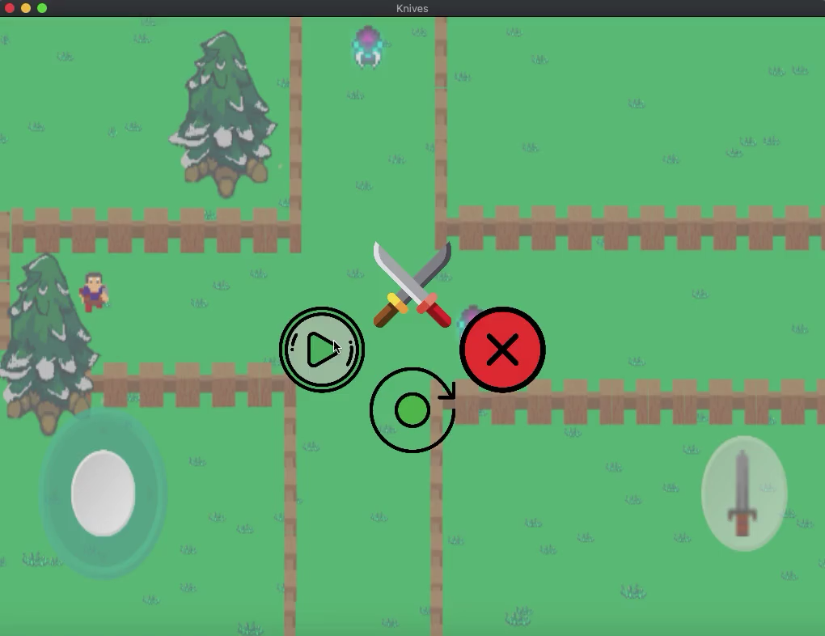
Knives
Developed a game called Knives in which the hero Matteo fights Gorham the devour of worlds in Unity Game Engine
This Game is also on google play store: https://play.google.com/store/apps/details?id=com.Green.Knives

Slide 3
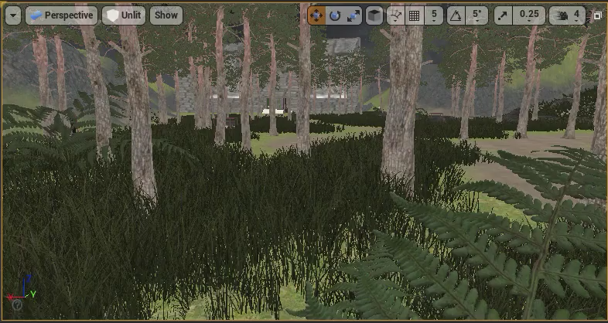
Survival Horror game
Participate in architecture, conception, and implementation of gameplay program for FPS game with gameplay mechanics using Hunger System, Inventory pickups, and player objectives, employing analytics to guide behavior of zombies with C++ in Unreal.
Created military simulation to enable user to Aim Down Sight and shoot using Ray Casts in Unreal, implementing innovative tools.
Designed environment for game setting using blend trees animation and 3-D mathematics, including all gameplay elements (features, animation, sound).

Slide 4
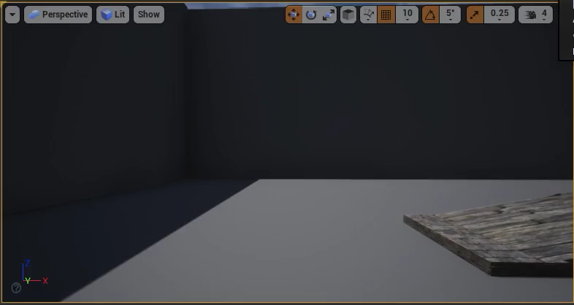
Foot-Placement Inverse Kinematics

